Slide 1
Software Development Tools
Version Control with Git/GitHub, Interactive Debugging & IDE Tools

Slide 2
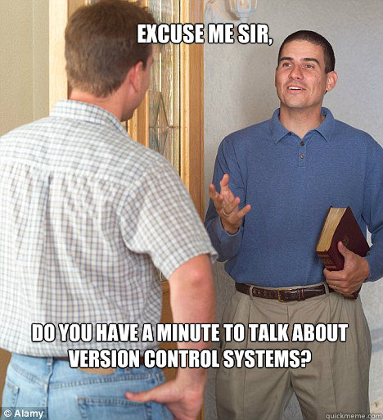
Life without version control = :(
The dog ate my files
I don’t have my USB drive with me
It used to work and I don’t know what I’ve changed
Oops I deleted the wrong file
Who changed the files?
Jimmy broke something…
Backup? What backup?

Slide 3
Life with version control = :)
A Version Control System (VCS) records changes to a ﬁle or set of files over time so you can recall speciﬁc versions later.
It allows you to:
Revert ﬁles to previous state
Revert entire project back to previous state
Compare changes over time
See who modiﬁed what
And more...
It means if you break your code or lose ﬁles, you can easily recover earlier saved state(s)

Slide 4

Why Git?
Everything is local (full history tree available offline)
Everything is fast
It is distributed - Git gives each developer a local copy of the entire development history
Not centralised (no single point of failure or bottleneck/slowness)
There are other version control systems (you may need to use these some day):
SVN (Subversion), CVS, Mercurial

Slide 5
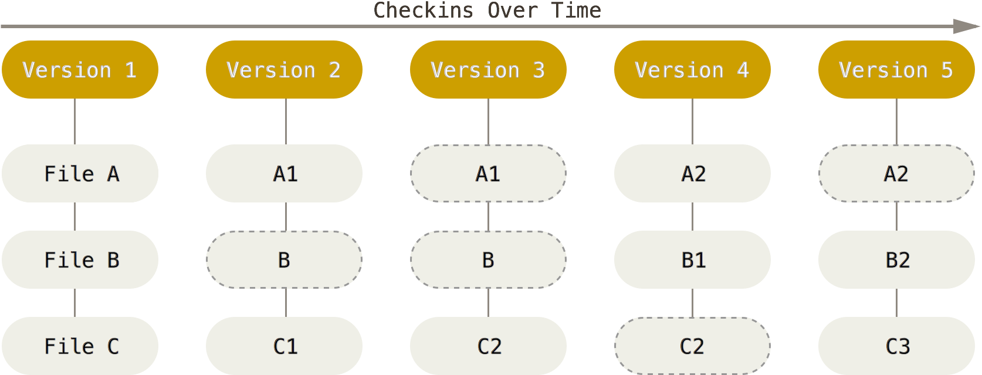
Why Git?
Git stores full snapshots, not diffs (differences between versions)

Slide 6

GitHub is a Web hosting service for projects that use Git
Git and GitHub are different things
You can use Git without using GitHub
Store your work on GitHub and you can access it anywhere
GitHub has become one of the most important parts of a developer’s CV (e.g. http://www.cnet.com/news/forget-linkedin-companies-turn-to-github-to-find-tech-talent/)
If you don’t have a GitHub account, create one now at https://github.com
Then ‘upgrade’ to the student account: https://education.github.com/discount_requests/new

Slide 7
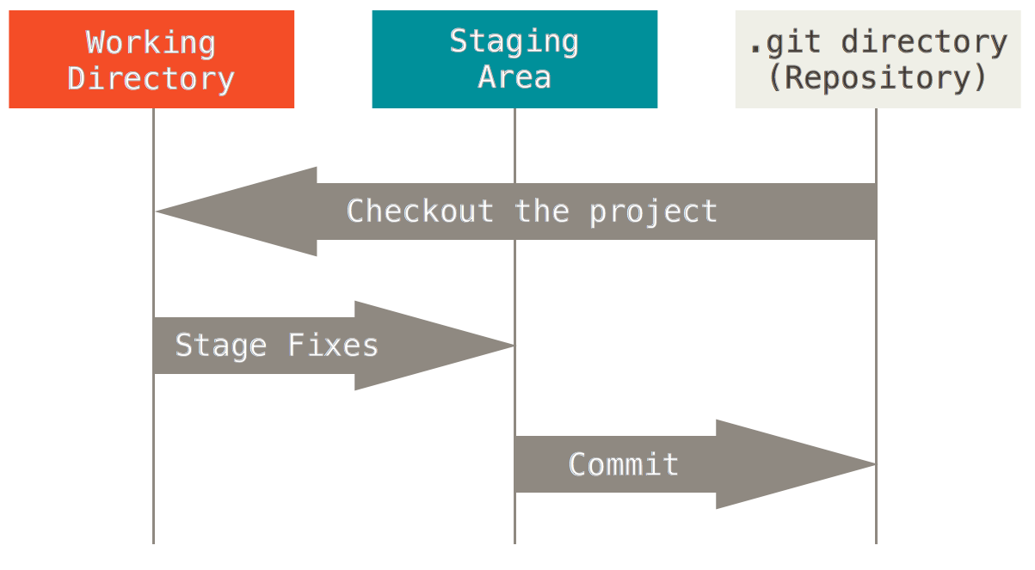
Git has three states your files can be in

Slide 8
The basic Git workflow goes like:
You modify files in your working directory.
You stage the files by adding them to your staging area.
You do a commit, which takes the files as they are in the staging area and stores that snapshot permanently to your Git directory.

Slide 9
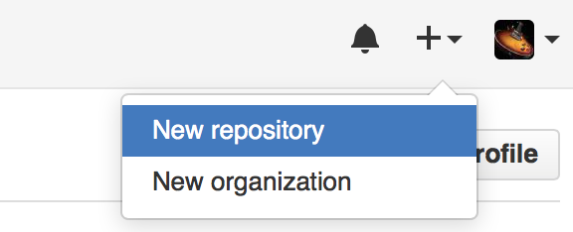
Create a repository (repo) for each project
Don’t store everything in one Git repository
Use one repo per project
Command line:
git init
On GitHub.com:

Slide 10
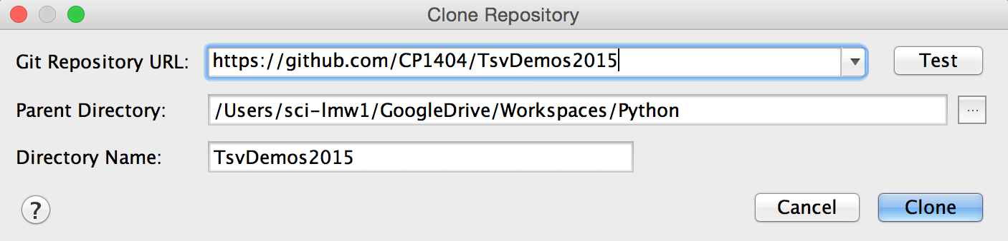
Use Git/GitHub directly in PyCharm
VCS > Import into Version Control > Share Project on GitHub or
Create the repository on GitHub first, then check it out in PyCharm
This sets the ‘remote’ for your local repo as the GitHub project automatically
VCS > Checkout from Version Control > GitHub
login, then enter URL:
Notes:
Copy any existing files into this new folder

Slide 11
Add files from your working directory to your Git project
Files in your project directory don’t automatically get added to your Git repository
Command line:
git add . (add all files)
git add filename (add one file)
PyCharm:
Select files in left pane and right-click, or:
VCS > Git > Add

Slide 12
Commit regularly… Every time you reach a small milestone
Each commit (check-in) saves your work (to the history)
Git only takes responsibility for data you’ve committed
Don’t wait too long between commits, e.g.
Every time a new feature is completed, passes a test
When you finish work in the lab for the day and need to change computers
Command line:
git commit
or git commit -a
PyCharm:
VCS > Commit Changes...

Slide 13
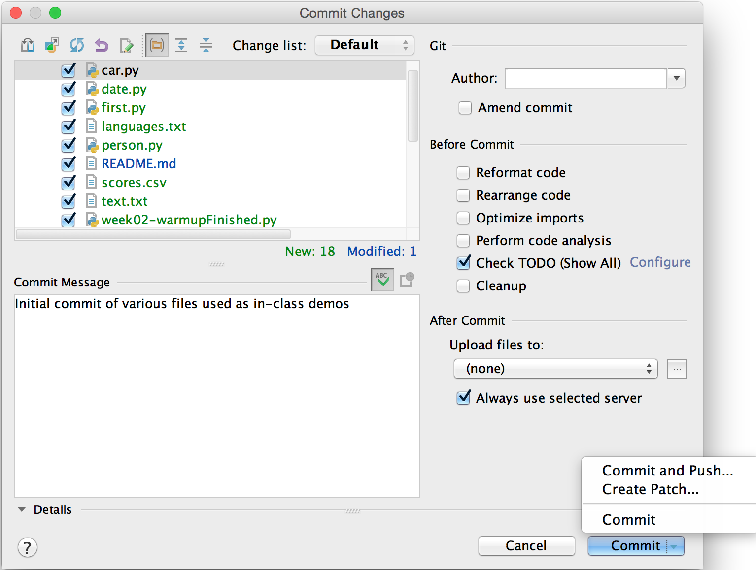
Use descriptive commit messages
Each commit is accompanied by a ‘commit message’
Descriptive commit messages are one of the best things you can do for others who use the repository… including you!
It lets people quickly understand changes without having to read code.

Slide 14
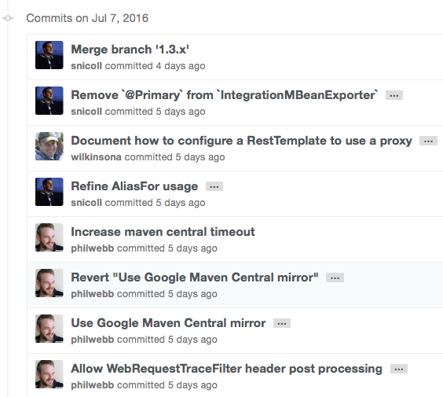
Use descriptive commit messages
Use the imperative voice for commit messages
Messages should read as the completion of the statement, "if applied, this commit will..." (but start with a capital)
If applied, this commit will Refactor subsystem X for readability
If applied, this commit will Update getting started documentation
If applied, this commit will Merge pull request #123 from user/branch
If applied, this commit will Release version 1.0.0
http://chris.beams.io/posts/git-commit/#imperative
https://github.com/spring-projects/spring-boot/commits/master
Notes:
e.g. "Refactor" not "Refactored"

Slide 15
Different versions are handled by commit history - or use branches
Do NOT make new folders in your project for different versions (e.g. if you’re trying a new idea)
Just commit, make changes, commit again…
You can always checkout an earlier version
Use branches to work on something new in a project and keep it separate (a branch is a full copy)
You can merge branches together later on
Command line:
git branch nameofbranch

Slide 16
Push = local -> server
Git maintains a local copy of your project and its history
To store this in GitHub or another remote, you push it
Command line:
git push (assuming remote is setup already)
PyCharm:
VCS > Git > Push
or do it when you “Commit and Push”

Slide 17
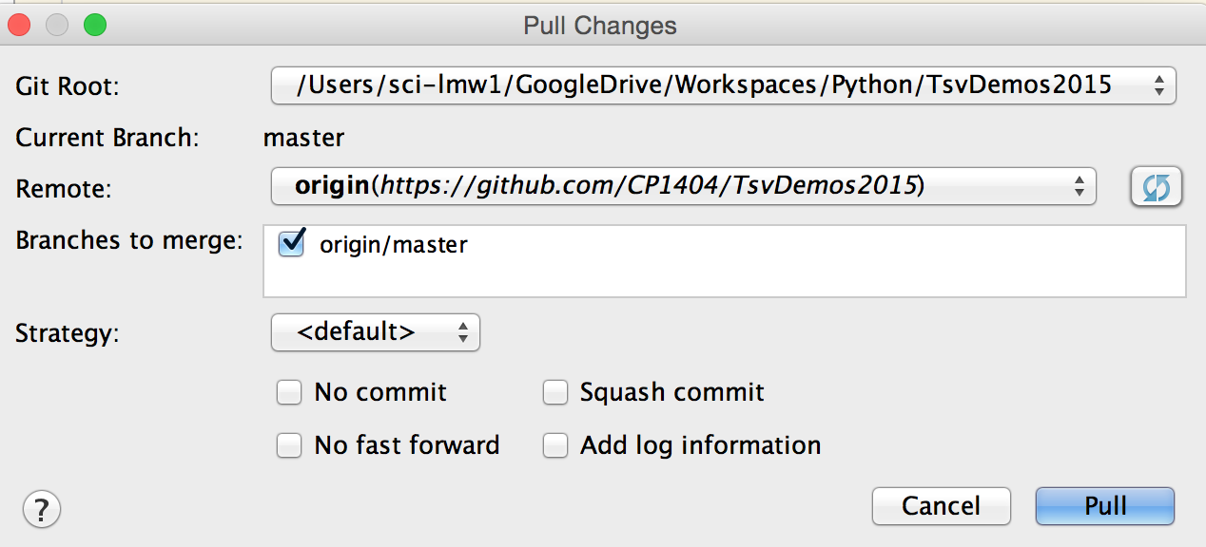
Pull = server -> local
If the server (GitHub) has a more recent version… to update your local copy of a project, pull changes from the server
Command line:
git pull (assuming remote is setup already)
PyCharm:
VCS > Git > Pull

Slide 18
Git Learning...
There’s a lot more to Git and GitHub
Forks, Pull Requests, Tags, Releases, Organisations, Collaborators, viewing status and logs...
Don’t try and learn everything to start with
Just start using it and it will all make sense
You’ll wonder how you ever survived without it!

Slide 19
Further reading
Learn Git commands interactively at: https://try.github.io
https://sethrobertson.github.io/GitBestPractices
Free “Pro Git” book: https://git-scm.com/book
PyCharm Git Integration: https://www.jetbrains.com/pycharm/help/using-git-integration.html
Another brilliant resource is: https://www.atlassian.com/git

Slide 20

Version Control Summary
Version control is extremely important and very helpful
Use Git and GitHub to store your code and keep track of revisions
Use good commit messages for all commits
Learn and use Git gradually, building up industry-relevant expertise

Slide 21
Interactive Debugging is a powerful tool
PyCharm (and many other IDEs) have this capability
It allows you to:
Step through your program one statement at a time
Watch how the value of variables change
It’s an important tool for fixing your code!

Slide 22
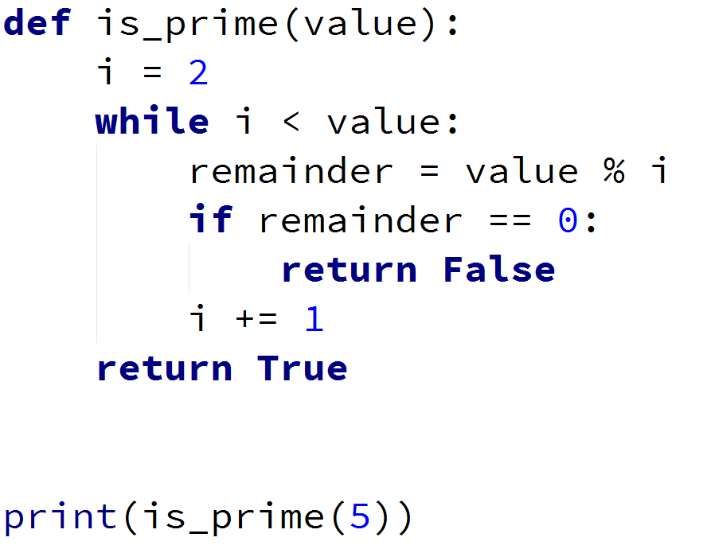
Here is a working program...
Questions:
How do we know that it is working correctly?
Do we really understand what it’s doing?

Slide 23
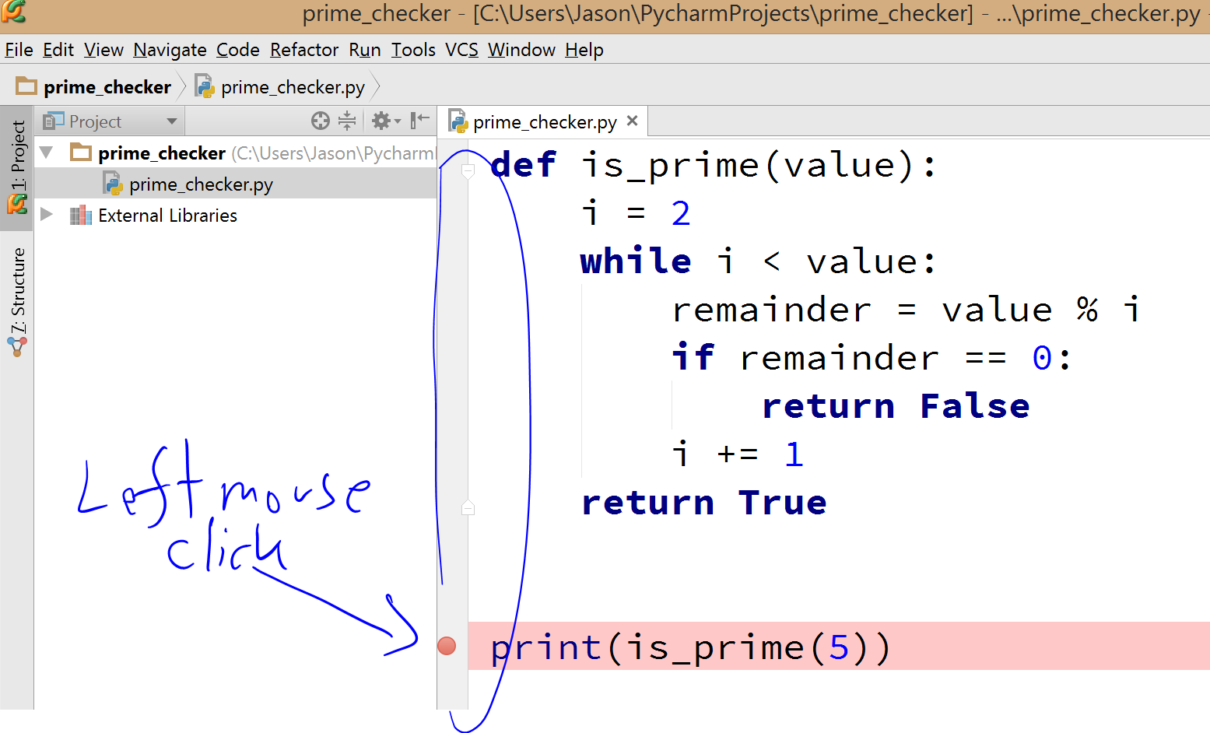
In PyCharm, we can add a breakpoint at a specific statement(s)
We do this to tell PyCharm’s Interactive Debugger where to stop normal execution

Slide 24
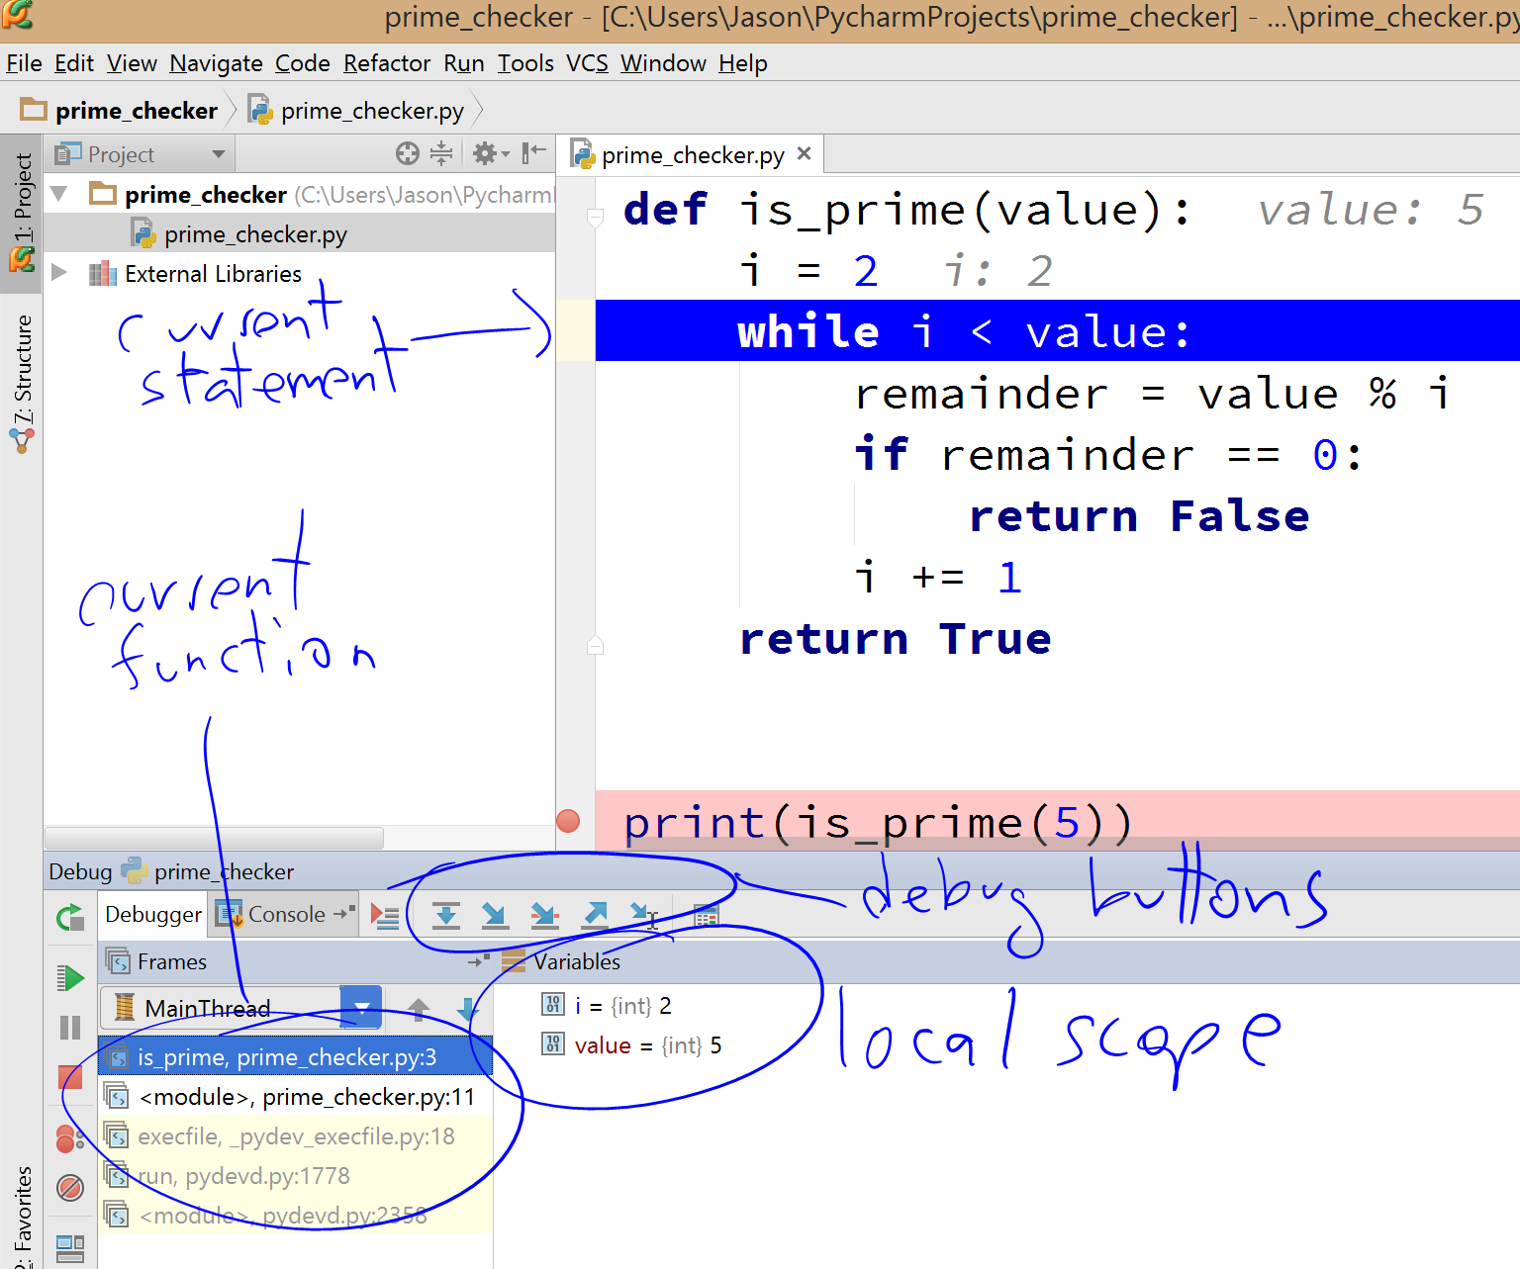
Next, we use the Debug View to control debug-mode execution
Useful features:
Frames - function calls
Details about variables
Debugging Buttons
Step-over
Step-into
Step-out

Slide 25
Demo - Interactive Debugging
Check the following function works with PyCharm’s Interactive Debugger
def is_valid_label(label): """ Determine if the input label matches the requirements: labels must start with a capital, have at least 5 characters
and at least one number :return: True if label is valid, otherwise False """ if len(label) < 5: return False if not label[0].isupper(): return False for char in label: if not char.isnumeric(): return False return True

Slide 26
Pro-tip: get the most out of your IDE
Modern Integrated Development Environments are sophisticated and very powerful programs
They are designed to help you work better on your code!
E.g. PyCharm IDE offers the following features:
Code completion & generation
Coding style suggestions
Refactoring wizards
and much more...

Slide 27
‘Real’ programmers don’t waste time
Don’t think that using shortcuts and IDE features is just for noobs who can’t code properly
You should be able to code in any editor, do all your own editing with no helpful features, but…
choose to use any tools that improve your work
speed and quality

Slide 28

PyCharm Powerups
Number 1 - get used to using keyboard shortcuts, e.g.
commenting Ctrl+/ (Mac: replace Ctrl with Cmd)
deleting lines Ctrl+y
duplicate line Ctrl+d
moving lines Ctrl+Shift+Up/Down
This isn’t just faster, it’s less error-prone
Use autocomplete and code suggestions
press Ctrl+Space to invoke suggestions if needed
Get into the habit of refactoring, not just changing text
All IDEs have similar productivity-boosting tools
Notes:
Demo

Slide 29
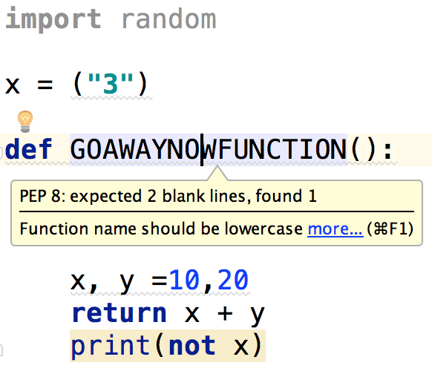
PyCharm checks your code on the fly!
Use this to become a better coder
Look out for underlines,
hover to find out what the problems are,
and fix them... (use the light bulb)
Can you find 7 problems with this code?
(all inspected by PyCharm)

Slide 30
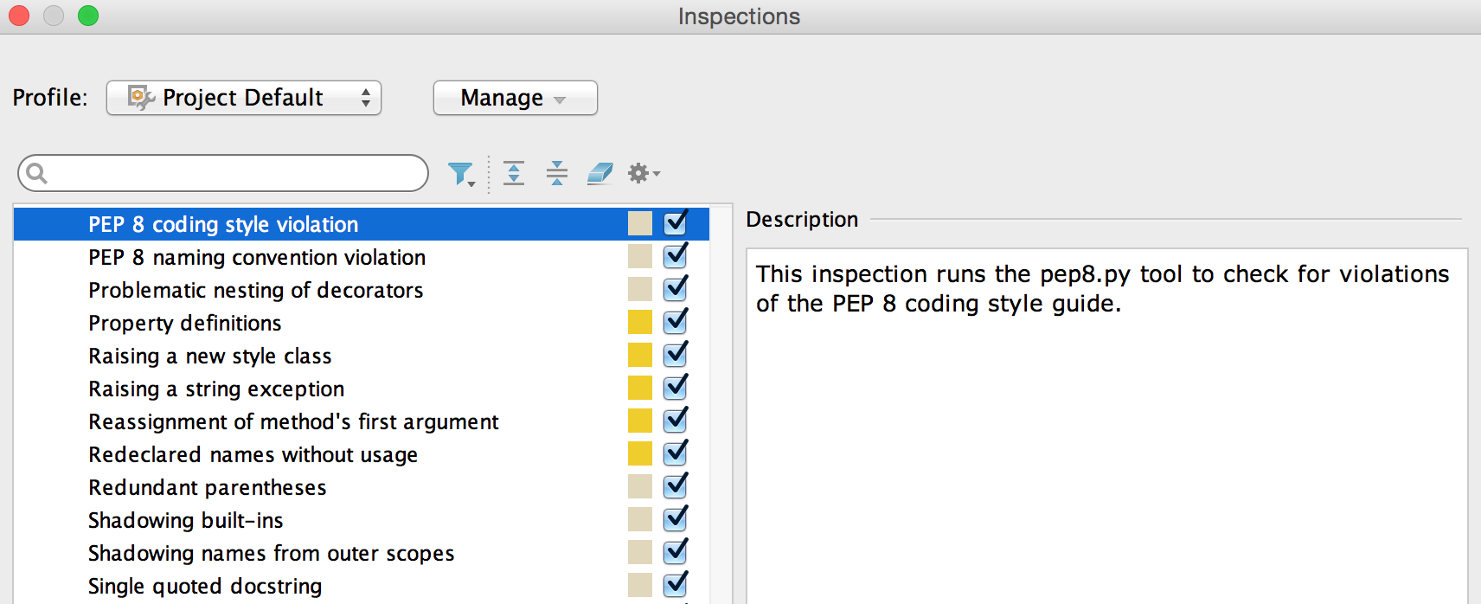
You can customise PyCharm’s inspections
Turn on or off the things PyCharm looks out for in the settings

Slide 31
Problem to solve together - Grades Program
Use a menu to present the user with options, as shown in the output below.
Calculating a grade is based on the user's score: <50 = N, 50-64 = P, 65-74 = C, 75-84 = D, >= 85 = HD. (Floats should be handled, e.g. 74.95 is a C.)
Use a function that only calculates the grade, but does not display it.
Use a "dummy" function for calculateGPA initially.
Name: Jimbo Hello Jimbo. Choose: (D)etermine Grade (C)alculate GPA (Q)uit >>> i Invalid option Hello Jimbo. Choose: (D)etermine Grade (C)alculate GPA (Q)uit >>> d | What is your total score? 67 Your grade is: C Hello Jimbo. Choose: (D)etermine Grade (C)alculate GPA (Q)uit >>> D What is your total score? 85 Your grade is: HD Hello Jimbo. Choose: (D)etermine Grade (C)alculate GPA (Q)uit | >>> c Your GPA is ... Hello Jimbo. Choose: (D)etermine Grade (C)alculate GPA (Q)uit >>> q Thank you.
Notes:
NOTE: Very important. You could write a function that takes no parameters and returns nothing, but asks the user for a score and prints the grade, BUT then you could ONLY use this function in the situation where you want to do those two things. What if you wanted to read a file of scores and write the grades to another file? You'd need another nearly-identical function. SO INSTEAD... Pass the score in as an input parameter and return the grade (string) - displaying it should be done in the main function.

Slide 32
Problem to solve together - Grades Program
Add error-checking to ensure the input score is between 0 and 100
Add the calculateGPA facility to your grade program:
It should ask the user for each of their subject scores (raw numbers), convert the score to a grade, convert the grade to a weight, then calculate the average of those.
Use a while loop to get their scores until they enter a negative value (that's the sentinel or stopping condition).
If we were able to use lists, we could store each score for later and our GPA function could accept a list, but we will just calculate the total on the fly, so we need to keep track of the number of subjects.
Weights for GPA are: N = 1.5, P = 4, C = 5, D = 6, HD = 7 (how could we store these values?)
Think about what functions you need to write and what functions you can reuse.

